Slide 1
Link Analysis: PageRank and HITS
CS224W: Social and Information Network Analysis
Jure Leskovec, Stanford University
http://cs224w.stanford.edu

Slide 2
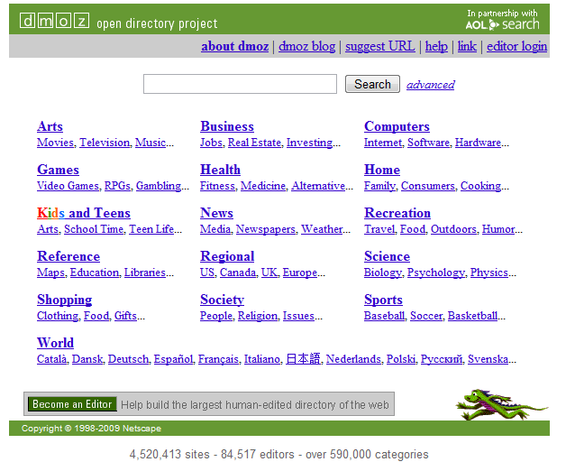
How to Organize the Web?
How to organize/navigate it?
First try: Human curated Web directories
Yahoo,
DMOZ,
LookSmart

Slide 3
Information Retrieval
SEARCH!
Find relevant docs in a small and trusted set:
Newspaper articles
Patents, etc.
Two traditional problems:
Synonimy: buy – purchase, sick – ill
Polysemi: jaguar

Slide 4
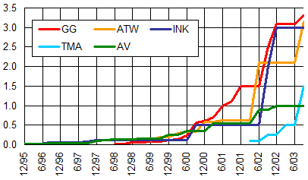
The Index Size Wars
Does more documents mean better results?

Slide 5
Web Search vs. Inf. Retrieval
What is “best” answer to query “Emory”?
Anchor Text: I go to Emory where I study
What about query “newspaper”?
No single right answer
Scarcity (IR) vs. abundance (Web) of information
Web: Many sources of information. Who to “trust”?
Trick:
Pages that actually know about newspapers might all be pointing to many newspapers
Ranking!

Slide 6
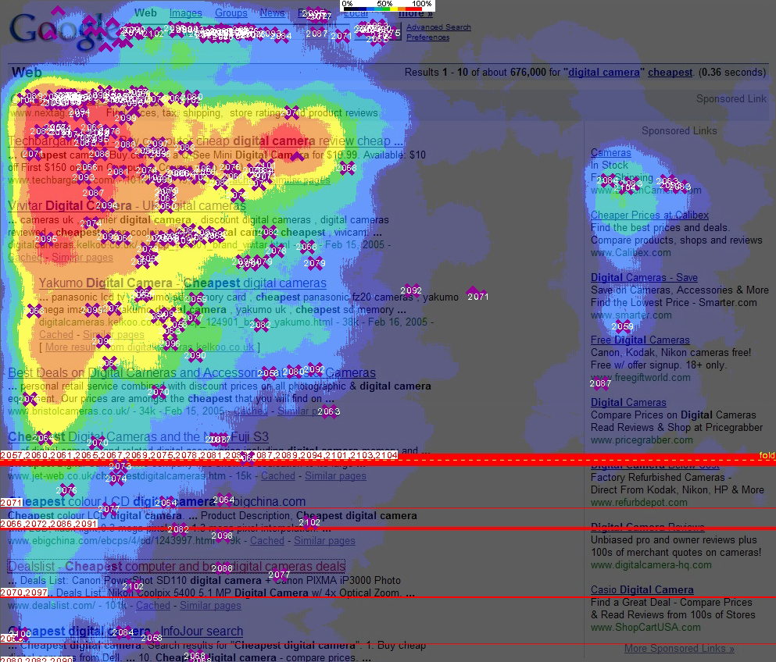
Ranking: Where do people look at?
the “golden triangle”

Slide 7
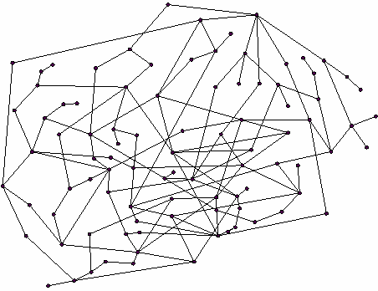
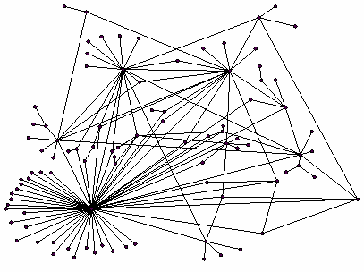
Ranking Nodes on the Graph
Web pages are not equally “important”
www.joe-schmoe.com vs. www.stanford.edu
We already know: Since there is large diversity in the connectivity of the webgraph we can rank the pages by the link structure
vs.

Slide 8
Link Analysis Algorithms
We will cover the following Link Analysis approaches to computing importances of nodes in a graph:
Hubs and Authorities (HITS)
Page Rank
Topic-Specific (Personalized) Page Rank
Sidenote: Various notions of node centrality: Node u
Degree dentrality = degree of u
Betweenness centrality = #shortest paths passing through u
Closeness centrality = avg. length of shortest paths from u to all other nodes
Eigenvector centrality = like PageRank

Slide 9
Link Analysis
Goal (back to the newspaper example):
Don’t just find newspapers. Find “experts” – people who link in a coordinated way to good newspapers
Idea: Links as votes
Page is more important if it has more links
In-coming links? Out-going links?
Hubs and Authorities Each page has 2 scores:
Quality as an expert (hub):
Total sum of votes of pages pointed to
Quality as an content (authority):
Total sum of votes of experts
Principle of repeated improvement
NYT: 10
Ebay: 3
Yahoo: 3
CNN: 8
WSJ: 9

Slide 10
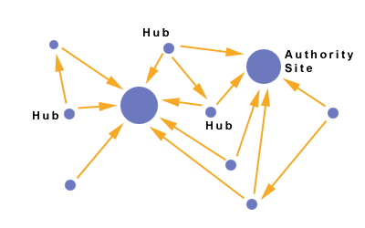
Hubs and Authorities
Interesting pages fall into two classes:
Authorities are pages containing useful information
Newspaper home pages
Course home pages
Home pages of auto manufacturers
Hubs are pages that link to authorities
List of newspapers
Course bulletin
List of US auto manufacturers
NYT: 10
Ebay: 3
Yahoo: 3
CNN: 8
WSJ: 9

Slide 11
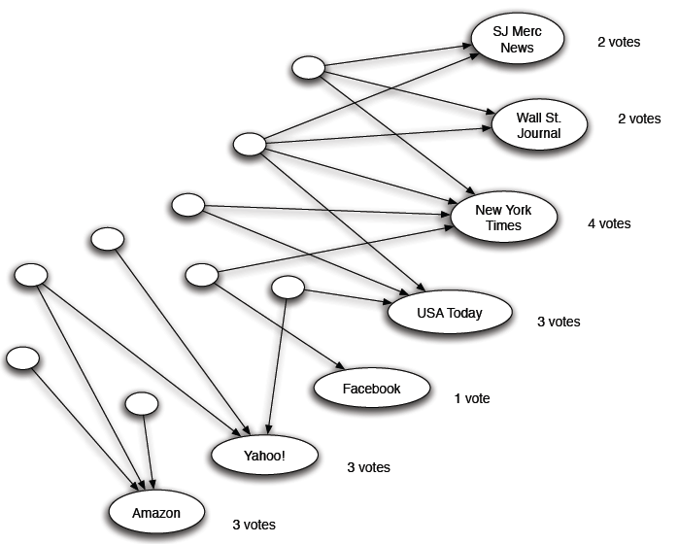
Counting in-links: Authority

Slide 12
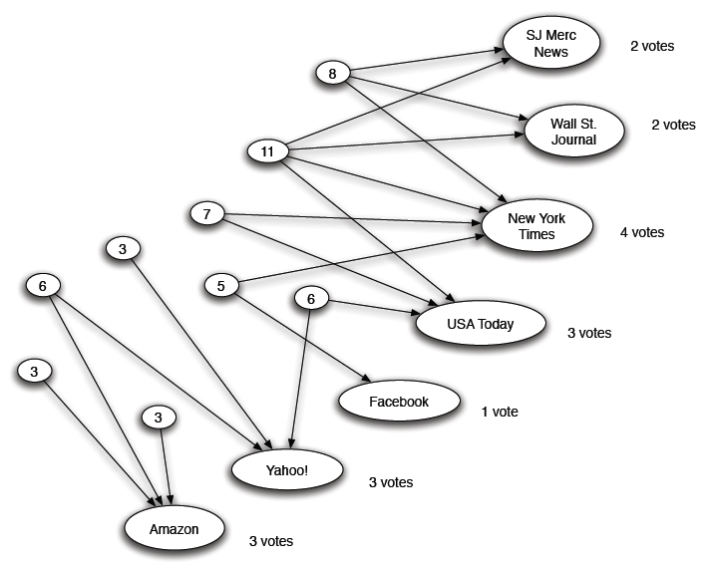
Expert quality: Hub

Slide 13
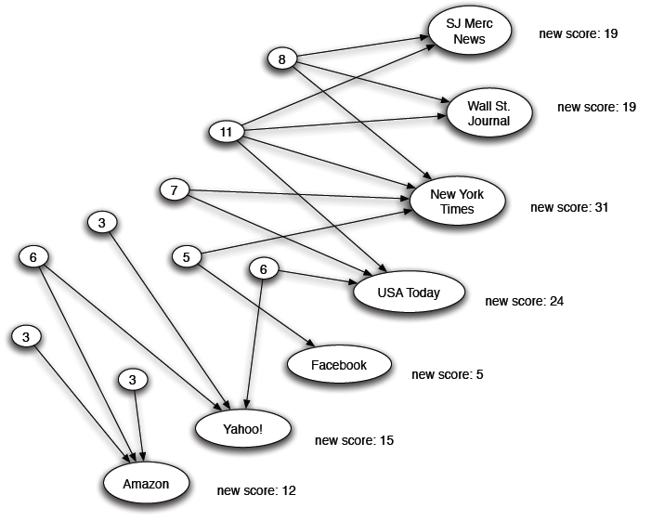
Reweighting

Slide 14
Mutually Recursive Definition
A good hub links to many good authorities
A good authority is linked from many good hubs
Model using two scores for each node:
Hub score and Authority score
Represented as vectors h and a

Slide 15
Hubs and Authorities
[Kleinberg ‘98]
j₁
j₂
j₃
j₄
Each page i has 2 scores:
Authority score: $a_{i}$
Hub score: $h_{i}$
HITS algorithm:
Initialize: $a_{j}=1, h_{i}=1$
Then keep iterating:
$∀i:$Authority: $a_{i}=\sum_{j→i}{h_{j}}$
$∀i:$Hub: $h_{i}=\sum_{i→j}{a_{j}}$
$∀i:$normalize: $\sum_{j}{a_{j}}=1$, $\sum_{j}{h_{j}}=1$
i
$$a_{i}=\sum_{j→i}{h_{j}}$$
i
j₁
j₂
j₃
j₄
$$h_{i}=\sum_{i→j}{a_{j}}$$

Slide 16
Hubs and Authorities
[Kleinberg ‘98]
HITS converges to a single stable point
Slightly change the notation:
Vector a = (a₁…,a_{n}), h = (h₁…,h_{n})
Adjacency matrix (n x n): M_{ij}=1 if ij
Then:
So:
And likewise:

Slide 17
Hubs and Authorities
HITS algorithm in new notation:
Set: a = h = 1^{n}
Repeat:
h=Ma, a=M^{T}h
Normalize
Then: a=M^{T}(Ma)
Thus, in 2k steps: a=(M^{T} M)^{k} a h=(M M^{T})^{k} h
new h
a is being updated (in 2 steps):
M^{T}(M a)=(M^{T} M) a
h is updated (in 2 steps):
M (M^{T} h)=(MM^{T}) h
new a
Repeated matrix powering

Slide 18
Eigenvalues & Eigenvectors
Definition:
Let Ax= λx for some scalar λ, vector x, matrix A
Then x is an eigenvector, and λ is its eigenvalue
Fact:
If A is symmetric (A_{ij}=A_{ji}) (in our case M^{T} M and M M^{T} are symmetric)
Then A has n orthogonal unit eigenvectors w₁…w_{n} that form a basis (coordinate system) with eigenvalues λ₁... λ_{n} (|λ_{i}|≥|λ_{i+1}|)

Slide 19
How to Think About A·x?
Let’s write x in coordinate system w₁…w_{n}
x=∑_{i} α_{i} w_{i}
x has coordinates (α₁,…, α_{n})
Suppose: λ₁ ... λ_{n} (|λ₁| ≥ … ≥ |λ_{n}|)
A^{k}x = λ^{k} x = ∑_{i} λ_{i}^{k} α_{i} w_{i}
As k→∞, if we normalize A^{k} x → λ₁ α₁ w₁
(contribution of all other coordinates → 0)
So authority a is eigenvector of M^{T} M associated with largest eigenvalue λ₁
Similarly: hub h is eigenvector of M M^{T}
$$Ax=λx$$
$$\lim_{k→∞}{\frac{{λ_{1}}^{k}}{{λ_{2}}^{k}}={\left(\frac{λ_{1}}{λ_{2}}\right)}^{k}→∞}$$

Slide 20
PageRank

Slide 21
PageRank: The “Flow” Model
A “vote” from an important page is worth more
A page is important if it is pointed to by other important pages
Define a “rank” r_{j} for node j
The web in 1839
y/2
y
a/2
y/2
m
a
m
a/2
Flow equations:
r_{y} = r_{y} /2 + r_{a} /2
r_{a} = r_{y} /2 + r_{m}
r_{m} = r_{a} /2

Slide 22
PageRank: Matrix Formulation
Stochastic adjacency matrix M
Let page j has d_{j} out-links
If j → i, then M_{ij} = 1/d_{j} else M_{ij} = 0
M is a column stochastic matrix
Columns sum to 1
Rank vector r: vector with an entry per page
r_{i} is the importance score of page i
∑_{i} r_{i} = 1
The flow equations can be written r = M r

Slide 23
Random Walk Interpretation
Imagine a random web surfer:
At any time t, surfer is on some page u
At time t+1, the surfer follows an out-link from u uniformly at random
Ends up on some page v linked from u
Process repeats indefinitely
Let:
p(t) … vector whose i^{th} coordinate is the prob. that the surfer is at page i at time t
p(t) is a probability distribution over pages
i₁
i₂
i₃
j

Slide 24
The Stationary Distribution
i₁
i₂
i₃
Where is the surfer at time t+1?
Follows a link uniformly at random
p(t+1) = Mp(t)
Suppose the random walk reaches a state p(t+1) = Mp(t) = p(t)
then p(t) is stationary distribution of a random walk
Our rank vector r satisfies r = Mr
So, it is a stationary distribution for the random walk
j

Slide 25
PageRank: How to solve?
Given a web graph with n nodes, where the nodes are pages and edges are hyperlinks
Assign each node an initial page rank
Repeat until convergence
calculate the page rank of each node
d_{i} …. out-degree of node i

Slide 26
PageRank: How to solve?
Power Iteration:
Set $r_{j}=1$
$r_{j}=\sum_{i→j}{\frac{r_{i}}{d_{i}}}$
And iterate
Example:
r_{y} 1/3 1/3 5/12 9/24 6/15
r_{a} = 1/3 3/6 1/3 11/24 … 6/15
r_{m} 1/3 1/6 3/12 1/6 3/15
y
 | y | a | m
y | ½ | ½ | 0
a | ½ | 0 | 1
m | 0 | ½ | 0
a
m
r_{y} = r_{y} /2 + r_{a} /2
r_{a} = r_{y} /2 + r_{m}
r_{m} = r_{a} /2
Iteration 0, 1, 2, …

Slide 27
PageRank: Three Questions
Does this converge?
Does it converge to what we want?
Are results reasonable?
or
equivalently

Slide 28
Does This Converge?
Example:
r_{a} 1 0 1 0
r_{b} 0 1 0 1
a
b
=
Iteration 0, 1, 2, …

Slide 29
Does it Converge to What We Want?
Example:
r_{a} 1 0 0 0
r_{b} 0 1 0 0
a
b
=
Iteration 0, 1, 2, …

Slide 30
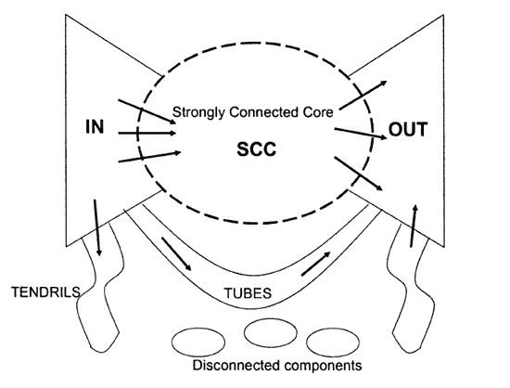
RageRank: Problems
2 problems:
Some pages are “dead ends” (have no out-links)
Such pages cause importance to “leak out”
Spider traps (all out links are within the group)
Eventually spider traps absorb all importance

Slide 31
Problems: Dead Ends
Power Iteration:
Set $r_{j}=1$
$r_{j}=\sum_{i→j}{\frac{r_{i}}{d_{i}}}$
And iterate
Example:
r_{y} 1/3 2/6 3/12 5/24 0
r_{a} = 1/3 1/6 2/12 3/24 … 0
r_{m} 1/3 1/6 1/12 2/24 0
y
 | y | a | m
y | ½ | ½ | 0
a | ½ | 0 | 0
m | 0 | ½ | 0
a
m
r_{y} = r_{y} /2 + r_{a} /2
r_{a} = r_{y} /2
r_{m} = r_{a} /2
Iteration 0, 1, 2, …

Slide 32
Problems: Spider Traps
Power Iteration:
Set $r_{j}=1$
$r_{j}=\sum_{i→j}{\frac{r_{i}}{d_{i}}}$
And iterate
Example:
r_{y} 1/3 2/6 3/12 5/24 0
r_{a} = 1/3 1/6 2/12 3/24 … 0
r_{m} 1/3 3/6 7/12 16/24 1
y
 | y | a | m
y | ½ | ½ | 0
a | ½ | 0 | 0
m | 0 | ½ | 1
a
m
r_{y} = r_{y} /2 + r_{a} /2
r_{a} = r_{y} /2
r_{m} = r_{a} /2 + r_{m}
Iteration 0, 1, 2, …

Slide 33
Looks a Lot Like…
Markov Chains
Set of states X
Transition matrix P where P_{ij} = P(X_{t}=i | X_{t-1}=j)
π specifying the probability of being at each state x ∈ X
Goal is to find π such that π = P π

Slide 34
Why is This Analogy Useful?
Markov chains theory
Fact: For any start vector, the power method applied to a Markov transition matrix P will converge to a unique positive stationary vector as long as P is stochastic, irreducible and aperiodic.

Slide 35
Make M Stochastic
Stochastic: every column sums to 1
e…vector of all 1
y
 | y | a | m
y | ½ | ½ | 1/3
a | ½ | 0 | 1/3
m | 0 | ½ | 1/3
r_{y} = r_{y} /2 + r_{a} /2 + r_{m} /3
r_{a} = r_{y} /2+ r_{m} /3
r_{m} = r_{a} /2 + r_{m} /3
a
m

Slide 36
Make M Aperiodic
A chain is periodic if there exists k > 1 such that the interval between two visits to some state s is always a multiple of k.
y
a
m

Slide 37
Make M Irreducible
From any state, there is a non-zero probability of going from any one state to any another.
y
a
m

Slide 38
Solution: Random Jumps
Google’s solution:
At each step, random surfer has two options:
With probability 1-β,
follow a link at random
With probability β,
jump to some page uniformly at random
PageRank equation [Brin-Page, 98] $\text{r}\text{=}(1−β)\sum_{i→j}{\frac{r_{i}}{d_{i}}}+β\frac{1}{n}$
Assuming we follow random teleport links with probability 1.0 from dead-ends
d_{i} … outdegree of node i

Slide 39
The Google Matrix
The Google Matrix:
$$G=\left(1−β\right)S+β\frac{1}{n}ee^{T}$$
G is stochastic, aperiodic and irreducible.
$$r^{(t+1)}=Gr^{(t)}$$
G is dense but computable using sparse mtx M
$G=\left(1−β\right)S+β\frac{1}{n}ee^{T}=$
$=\left(1−β\right)(M+\frac{1}{n}a^{T}e)+β\frac{1}{n}ee^{T}=$
$=\left(1−β\right)M+(\left(1−β\right)a^{T}+βe^{T})\frac{1}{n}e$

Slide 40
PageRank & Eigenvectors
PageRank as a principal eigenvector
r = Mr ⇔ r_{j}=∑_{i} r_{i}/d_{i}
But we really want: r_{j} = (1- β) ∑_{i→j} r_{i}/d_{i} + β
Define: M’_{ij} = (1- β) M_{ij} + β 1/n
Then: r = M’r
What is β?
In practice β =0.15 (5 links and jump)
d_{i} … out-degree of node i

Slide 41
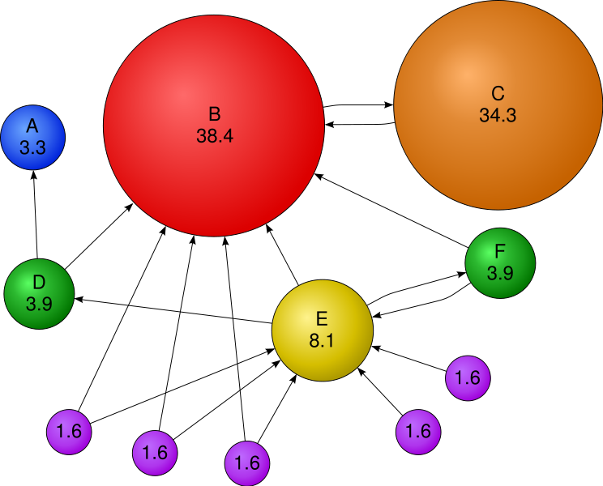
Example

Slide 42
PageRank and HITS
PageRank and HITS are two solutions to the same problem:
What is the value of an in-link from u to v?
In the PageRank model, the value of the link depends on the links into u
In the HITS model, it depends on the value of the other links out of u
The destinies of PageRank and HITS post-1998 were very different

Slide 43
Personalized PageRank and Applications

Slide 44
Personalized PageRank
Goal: Evaluate pages not just by popularity but by how close they are to the topic
Teleporting can go to:
Any page with equal probability
(we used this so far)
A topic-specific set of “relevant” pages
Topic-specific (personalized) PageRank
M’_{ij} = (1-β) M_{ij} + β /|S| if i in S (S...teleport set)
= (1-β) M_{ij} otherwise

Slide 45
PageRank: Applications
Graphs and web search:
Ranks nodes by “importance”
Personalized PageRank:
Ranks proximity of nodes to the teleport nodes S
Proximity on graphs:
Q: What is most related conference to ICDM?
Random Walks with Restarts
Teleport back: S={single node}
…
…
…
…
Conference
Author

Slide 46
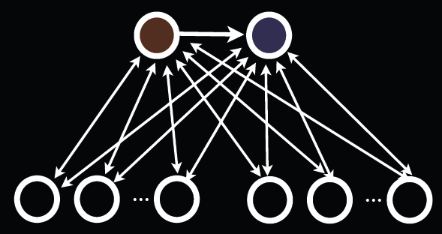
Application: TrustRank
Link Farms: networks of millions of pages design to focus PageRank on a few undeserving webpages
To minimize their influence use a teleport set of trusted webpages
E.g., homepages of universities

Slide 47
PageRank: Problems

Slide 48
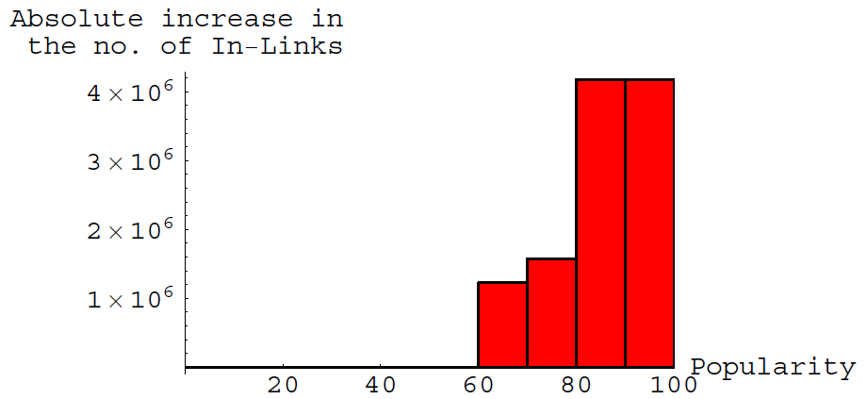
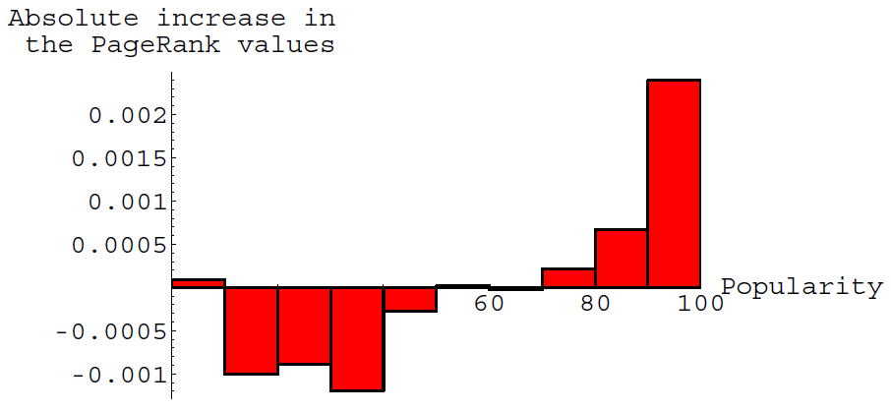
Issues with PageRank
http://oak.cs.ucla.edu/~cho/papers/cho-bias.pdf
Rich get richer [Cho et al., WWW ‘04]
Two snapshots of the web-graph at two different time points
Measure the change:
In the number of in-links
PageRank

Slide 49
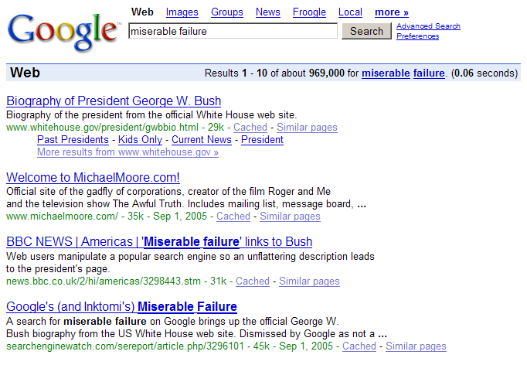
Google Bombs

