Slide 1

The Structure of
Information Networks
Strength of Weak Ties and Community Structure in Networks
with emphasis on information and social networks
Ymir Vigfusson

Slide 2
Networks: Flow of Information
How does information flows through the network?
How do different nodes play structurally distinct roles in this process?
How do different links (short range vs. long range) play different roles in diffusion?

Slide 3
Strength of Weak Ties
[Granovetter ‘73]
How people find out about new jobs?
  Mark Granovetter, part of his PhD in 1960s
  People find the information through personal contacts
But: Contacts were often acquaintances
rather than close friends
  This is surprising:
    One would expect your friends to help you out more than casual acquaintances when you are between the jobs
Why is it that distant acquaintances are most helpful?

Slide 4
Granovetter’s Answer
[Granovetter ‘73]
Two perspectives on friendships:
  Structural:
    Friendships span different portions
    of the network
  Interpersonal:
    Friendship between two people is either strong or weak

Slide 5
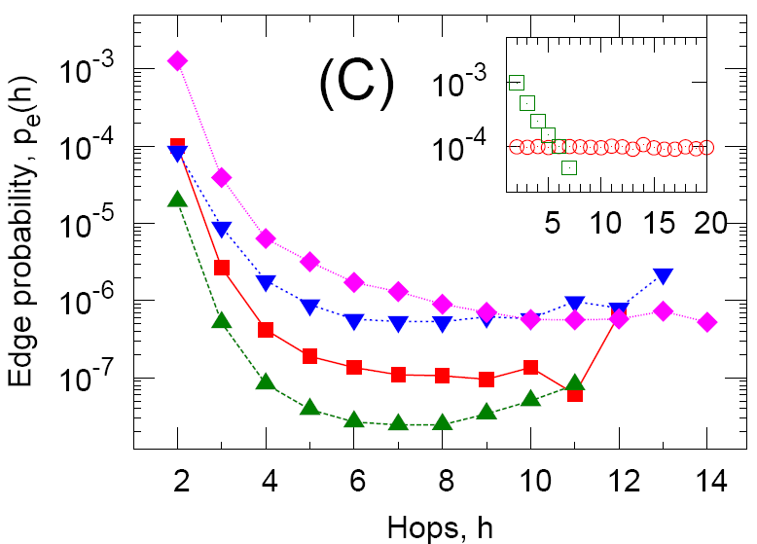
Triadic Closure
Which edge is more likely to form, a-b or a-c?
Triadic closure: If two people in a
network have a friend in common
there is an increased likelihood
they will become friends themselves
a
b
c

Slide 6
Triadic Closure
Triadic closure == High clustering coefficient
Reasons for triadic closure:
If B and C have a friend A in common, then:
  B is more likely to meet C
    (since they both spend time with A)
  B and C trust each other
    (since they have a friend in common)
  A has incentive to bring B and C together
    (as it is hard for A to maintain two disjoint relationships)
Empirical study by Bearman and Moody:
  Teenage girls with low clustering coefficient are
  more likely to contemplate suicide

Slide 7
Granovetter’s Explanation
Bridge
Define: Bridge edge
  If removed, it disconnects the graph
Define: Local bridge
  Edge of Span>2
  (i.e., Edge not in a triangle)
Two types of edges:
  Strong (friend) and
  weak ties (acquaintance)
Strong triadic closure:
  Two strong ties imply a third edge
Claim: If strong triadic closure satisfied
then local bridges are weak ties!
a
b
Local bridge
a
b
Edge:
W or S
S
S
W
S
S
S
W
S
a
b
S

Slide 8
Tie strength in real data
For many years the Granovetter’s
theory was not tested
But, today we have large
who-talks-to-whom graphs:
  Email, Messenger, Cell phones, Facebook
Onnela et al. 2007:
  Cell-phone network of 20% of country’s population
  Edge strength: # phone calls

Slide 9
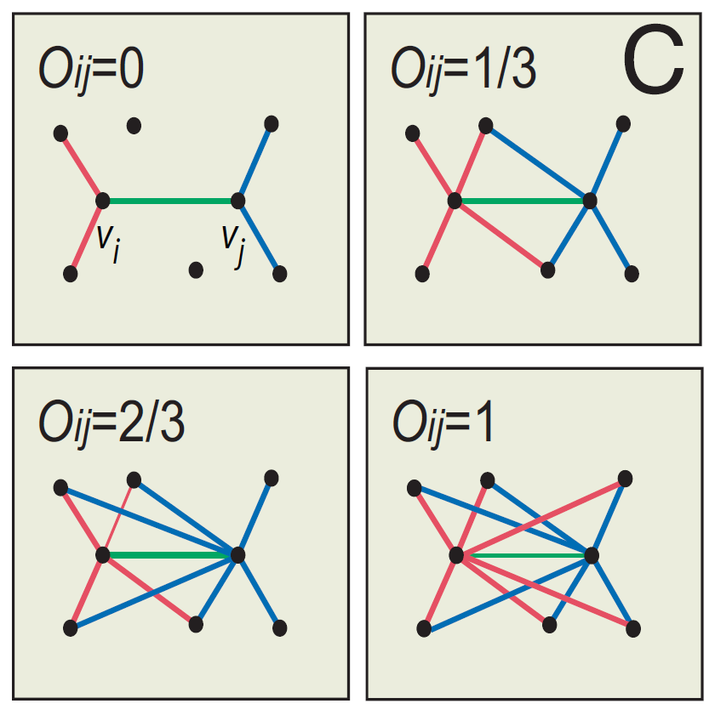
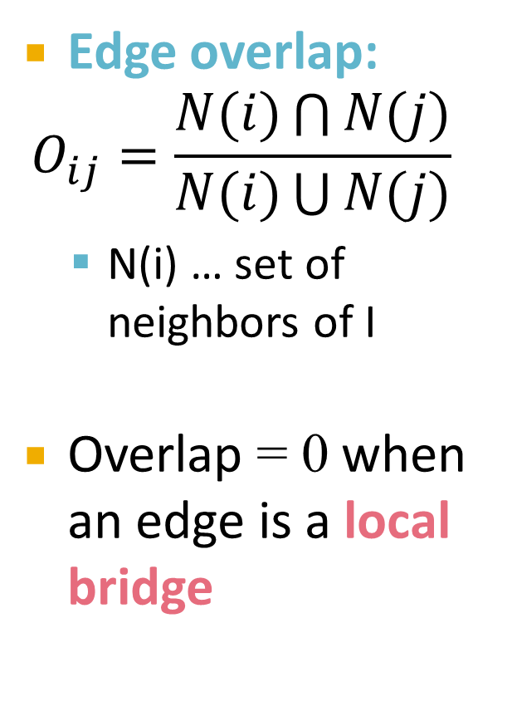
Neighborhood Overlap
Edge overlap:
$$O_{ij}=\frac{N(i)\bigcap{N(j)}}{N(i)\bigcup{N(j)}}$$
  N(i) … set of neighbors of I
Overlap = 0 when an edge is a local bridge

Slide 10
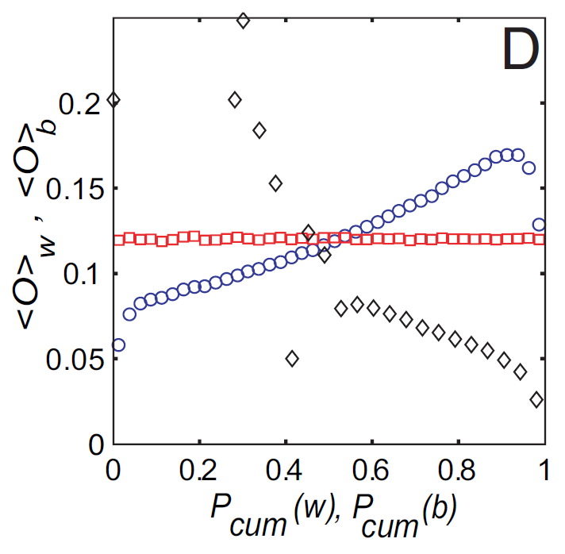
Phones: Edge Overlap vs. Strength
Cell-phone network
Observation:
  Highly used links
  have high overlap!
Legend:
  Permuted strengths: Keep
  the network structure
  but randomly reassign
  edge strengths
  Betweenness centrality: number of shortest paths going through an edge
True
Permuted strengths
Neighborhood overlap
Betweenness centrality
Edge strength (#calls)

Slide 11
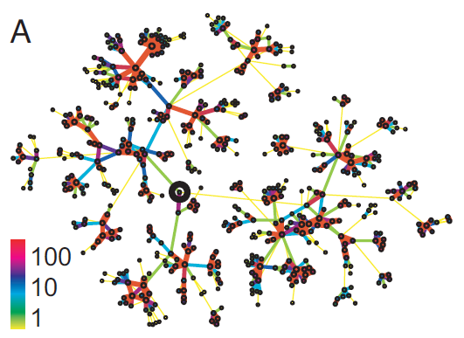
Real Network, Real Tie Strengths
Real edge strengths in mobile call graph
  Strong ties are more embedded (have higher overlap)

Slide 12
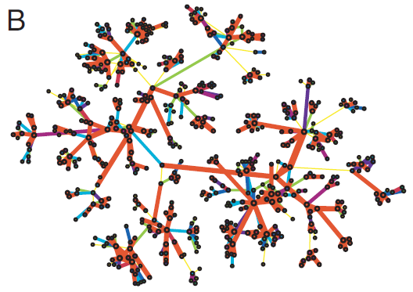
Real Net, Permuted Tie Strengths
Same network, same set of edge strengths
but now strengths are randomly shuffled

Slide 13
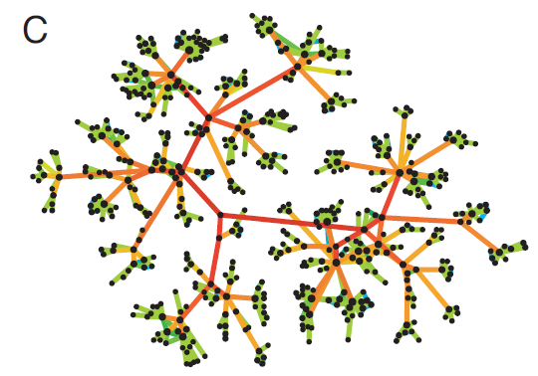
Edge Betweenness Centrality
b=16
b=7.5
Edges strength is labeled based on betweenness centrality (number of shortest paths passing through an edge)

Slide 14
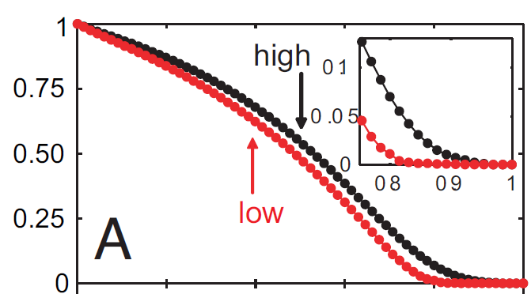
Link Removal by Strength
Low disconnects
the network sooner
Size of largest component
Fraction of removed links
Removing links by strength (#calls)
  Low to high
  High to low
Conceptual picture
of network structure

Slide 15
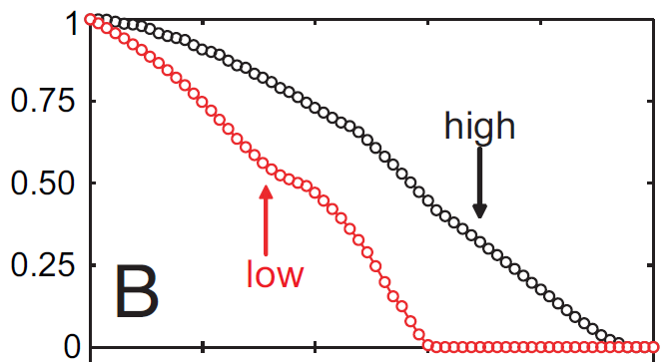
Link Removal by Overlap
Low disconnects
the network sooner
Size of largest component
Fraction of removed links
Removing links based on overlap
  Low to high
  High to low
Conceptual picture
of network structure

Slide 16
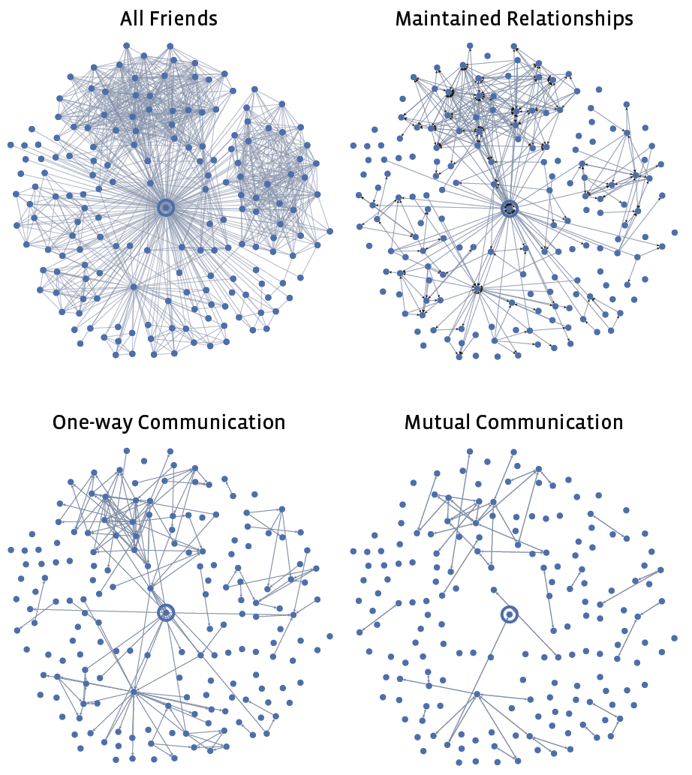
Another Example: Facebook
[Marlow et al. ‘09]

Slide 17
Small Detour:
Structural Holes

Slide 18
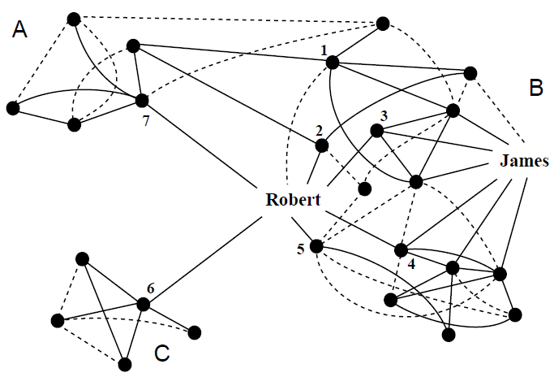
Small Detour: Structural Holes
[Ron Burt]

Slide 19
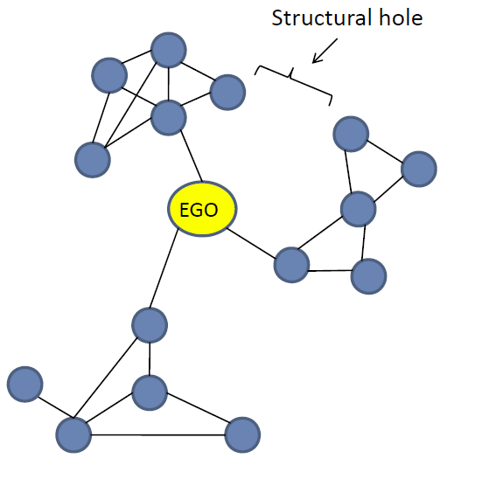
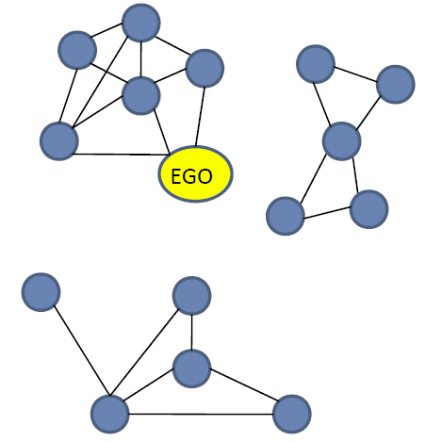
Structural Holes
Major structural holes
Spanning structural holes
Structural Holes provide ego with access
to novel information, power, freedom

Slide 20
Structural Holes: Network Constraint
The “network constraint” measure [Burt]:
  To what extent are person’s contacts redundant
    Low: disconnected contacts
    High: contacts that are
    close or strongly tied
k
p_{uv}=1/d_{u}
p_{ik}
k
2
p₂₅=½
p_{ij}
p₁₂=¼
i
j
i
3
1
5
p₁₅=¼
j
4
p
1 2 3 4 5
1 .00 .25 .25 .25 .25
2 .50 .00 .00 .00 .50
3 1.0 .00 .00 .00 .00
4 .50 .00 .00 .00 .50
5 .33 .33 .00 .33 .00
p_{uv} … prop. of u’s “energy” invested in relationship with v
Notes:
Cost of ties in part of the concept.

Slide 21
Example: Robert vs. James
Constraint: To what extent are person’s contacts redundant
  Low: disconnected contacts
  High: contacts that are close or strongly tied
Network constraint:
  James: c_{j}=0.309
  Robert: c_{r}=0.148

Slide 22
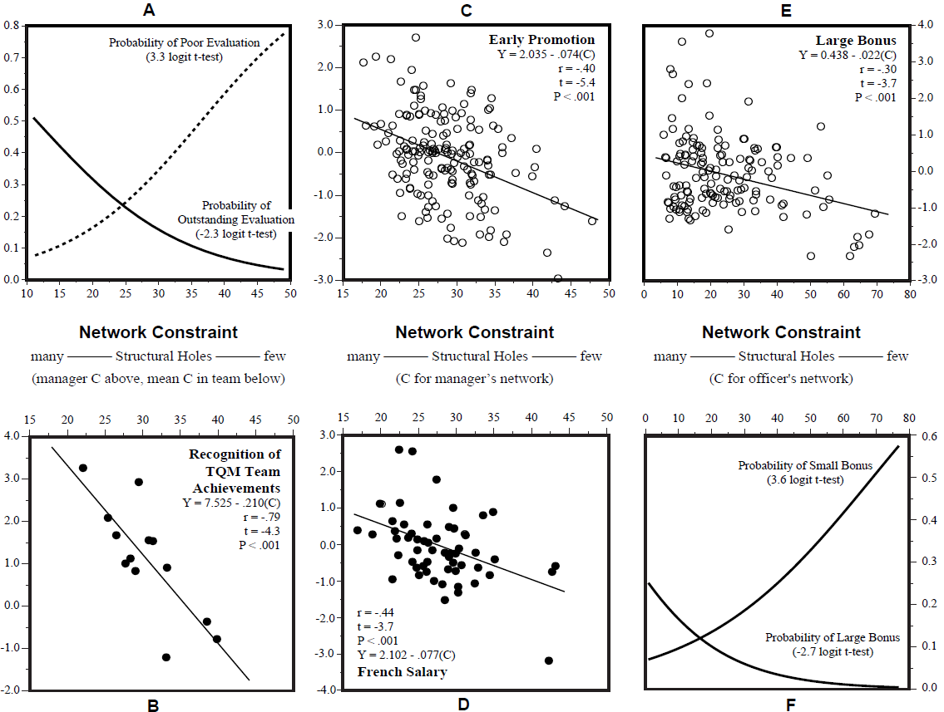
Spanning the Holes Matters
[Ron Burt]

Slide 23
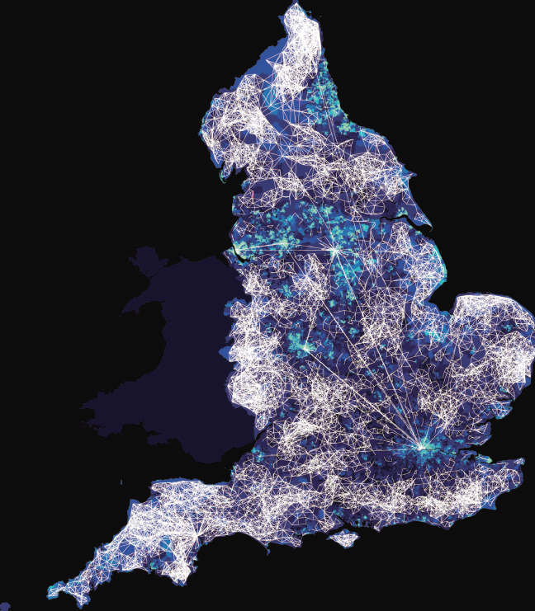
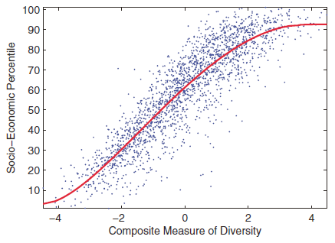
Diversity & Development
[Eagle-Macy, 2010]
Measure of diversity:
  ≈ 1-c_{i}
    structural holes + entropy of edge strengths

Slide 24
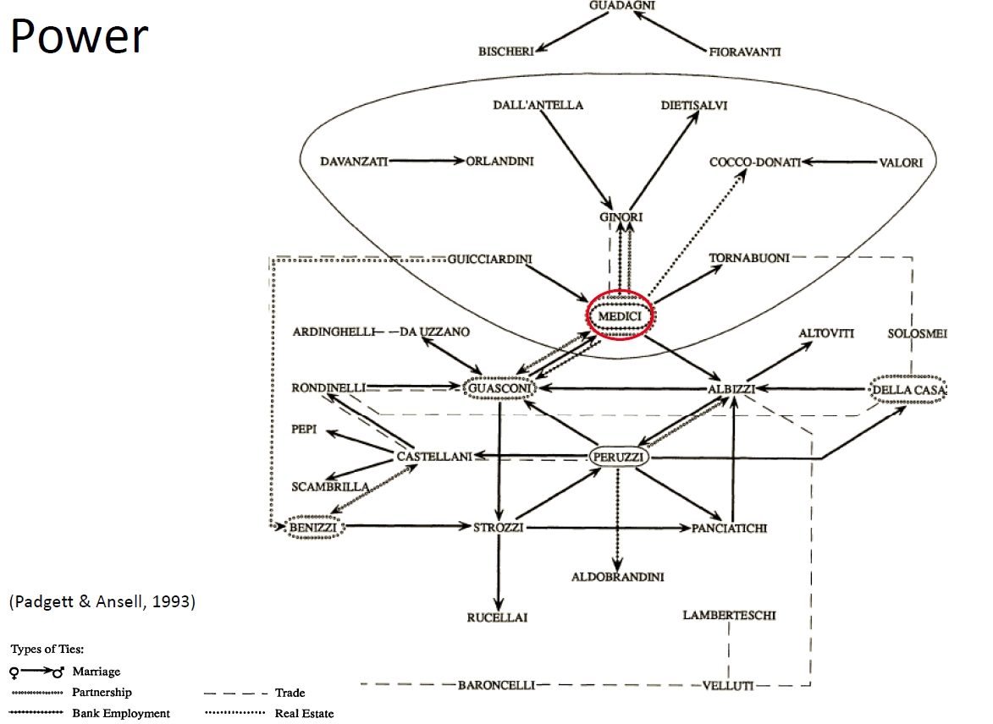
Florentine Families: Power

Slide 25
Network Communities

Slide 26
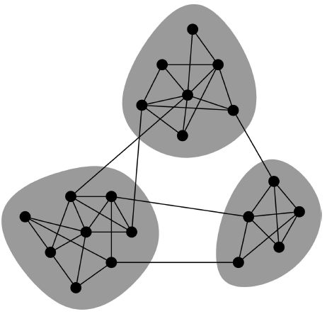
Network Communities
Networks of tightly connected groups
Network communities:
  Sets of nodes with lots of connections inside and few to outside (the rest of the network)
Communities, clusters, groups, modules

Slide 27
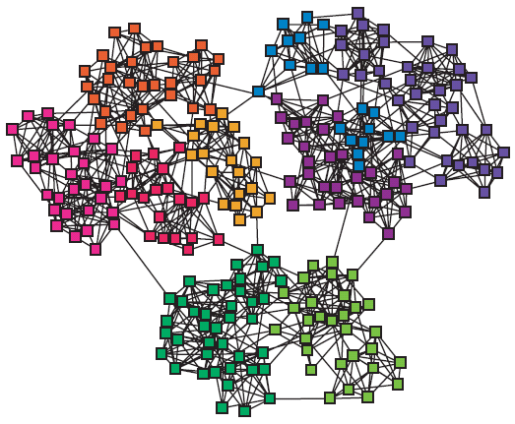
Finding Network Communities
How to automatically find such densely connected groups of nodes?
Ideally such automatically detected clusters would then correspond to real groups
For example:
Communities, clusters, groups, modules

Slide 28
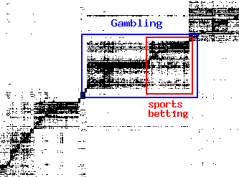
Micro-Markets in Sponsored Search
Find micro-markets by partitioning the “query x advertiser” graph:
query
advertiser

Slide 29
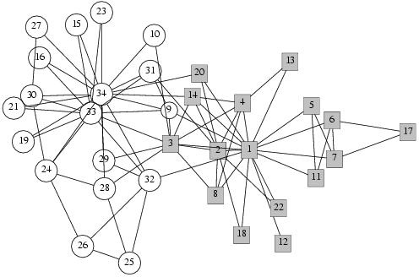
Social Network Data
Zachary’s Karate club network:
  Observe social ties and rivalries in a university karate club
  During his observation, conflicts led the group to split
  Split could be explained by a minimum cut in the network
Why would we expect such clusters to arise?

Slide 30
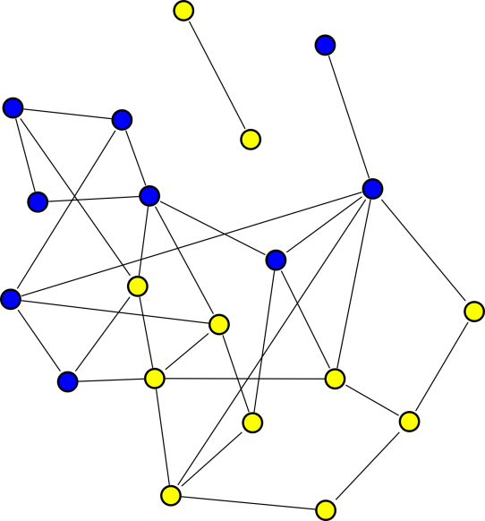
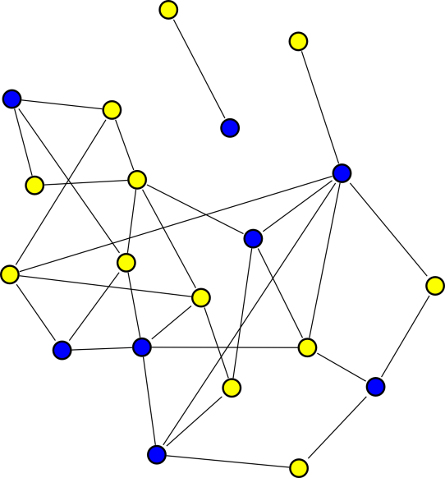
Group Formation in Networks
[Backstrom et al. KDD ‘06]
In a social network nodes explicitly declare group membership:
  Facebook groups, Publication venue
Can think of groups as node colors
Gives insights into social dynamics:
  Recruits friends? Memberships spread along edges
  Doesn’t recruit? Spread randomly
What factors influence a person’s decision to join a group?

Slide 31
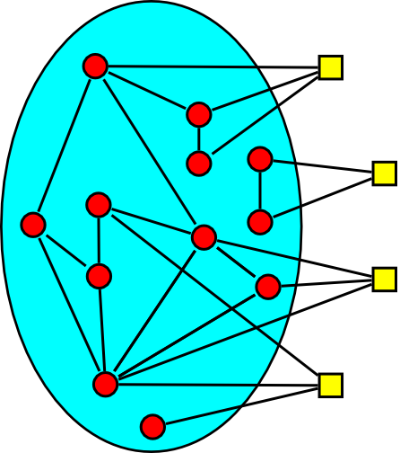
Group Growth as Diffusion
Analogous to diffusion Group memberships spread over the network:
  Red circles represent
  existing group members
  Yellow squares may join
Question:
  How does prob. of joining
  a group depend on the number of friends already
  in the group?

Slide 32
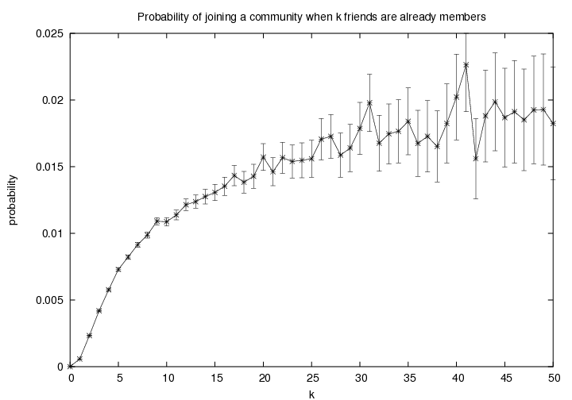
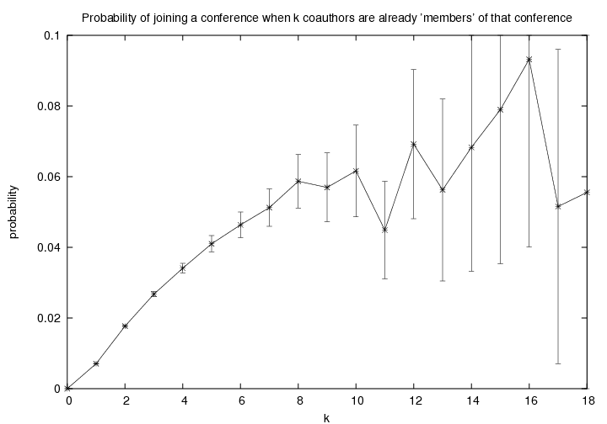
P(join) vs. # friends in the group
[Backstrom et al. KDD ‘06]
LiveJournal:
1 million users
250,000 groups
DBLP: 400,000 papers
100,000 authors
2,000 conferences
Diminishing returns:
  Probability of joining increases with the
  number of friends in the group
  But increases get smaller and smaller
Notes:
Very different data sets, same threshold sort of thing

Slide 33
Groups: More Subtle Features
Connectedness of friends:
  x and y have three friends in the group
  x’s friends are independent
  y’s friends are all connected
Who is more likely to join?
x
y

Slide 34
Connectedness of Friends
[Backstrom et al. KDD ‘06]
Competing sociological theories:
  Information argument [Granovetter ‘73]
  Social capital argument [Coleman ’88]
Information argument:
  Unconnected friends give independent support
Social capital argument:
  Safety/trust advantage in having friends
  who know each other
x
y

Slide 35
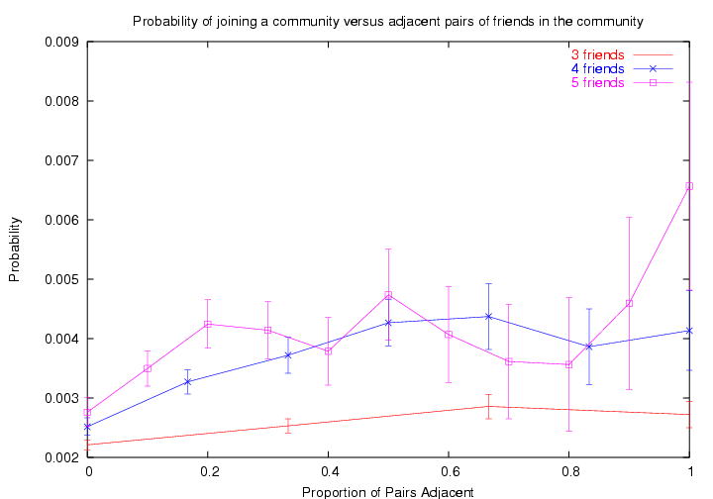
Connectedness of Friends
LiveJournal: 1 million users, 250,000 groups
Social capital argument wins!
Prob. of joining increases with the number of adjacent members.
Notes:
Going to a party/protest
Believing a rumor

Slide 36
So, This Means That
[Backstrom et al. KDD ‘06]
A person is more likely to join a group if
  she has more friends who
  are already in the group
  friends have more connections between themselves
So, groups form clusters of tightly connected nodes

Slide 37
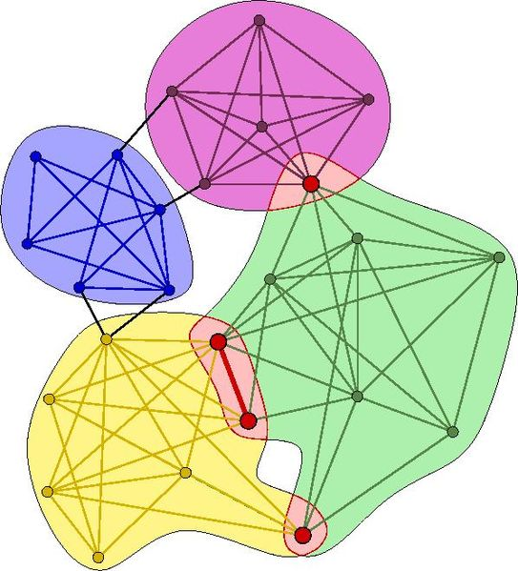
Community Detection
How to find communities?
We will work with undirected (unweighted) networks

Slide 38
Clustering and Community Finding
How to extract groups?
Many methods:
Hierarchical methods:
  Top-down/ bottom-up
Graph partitioning methods:
  Define “edge counting” metric – conductance, expansion, modularity, etc. – and optimize!
Spectral methods:
  Based on eigenvector decomposition of modified graph adjacency matrix
Clique percolation method:
  To extract overlapping communities in networks
No community overlaps

Slide 39
Method 1: Strength of Weak Ties
Intuition:
Edge strengths (call volume)
in real network
Edge betweenness
in real network

Slide 40
Method 1: Girvan-Newman
[Girvan-Newman ‘02]
Divisive hierarchical clustering based on the notion of edge betweenness:
  Number of shortest paths passing through the edge
Girvan-Newman Algorithm:
        Undirected unweighted networks
  Repeat until no edges are left:
    Calculate betweenness of edges
    Remove edges with highest betweenness
  Connected components are communities
  Gives a hierarchical decomposition of the network

Slide 41
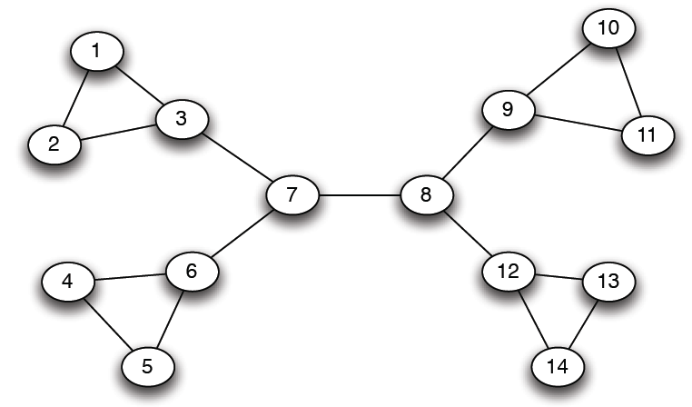
Girvan-Newman: Example
12
1
33
49
Need to re-compute betweenness at every step

Slide 42
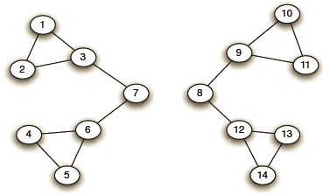
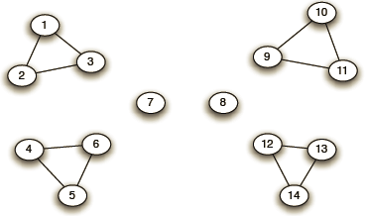
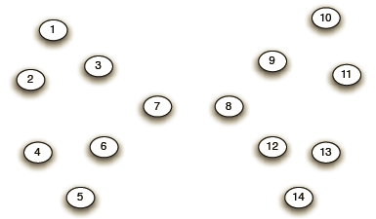
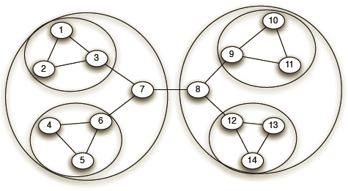
Girvan-Newman: Example
Step 1:
Step 2:
Step 3:
Hierarchical network decomposition:

Slide 43
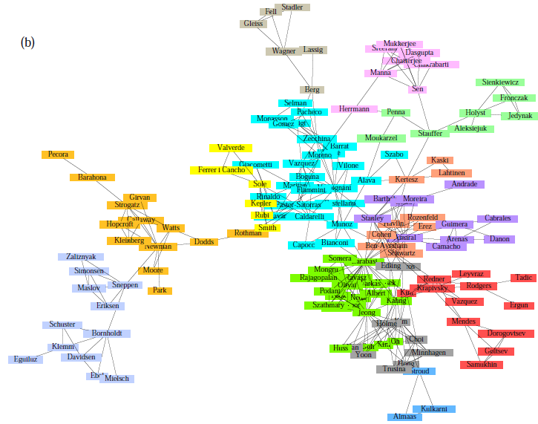
Girvan-Newman: Results
Communities in physics collaborations

Slide 44
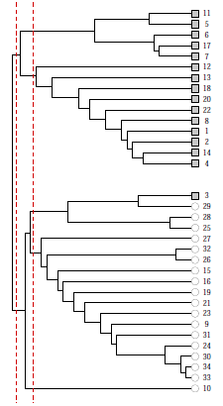
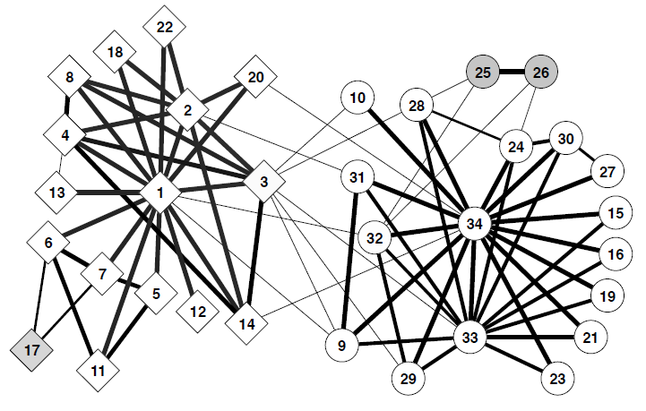
Girvan-Newman: Results
Zachary’s Karate club:
hierarchical decomposition

Slide 45
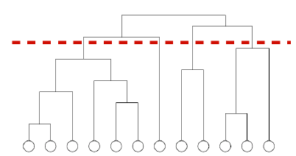
We need to resolve 2 questions
How to compute betweenees?
How to select the number of clusters?

Slide 46
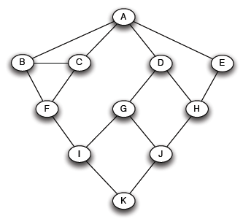
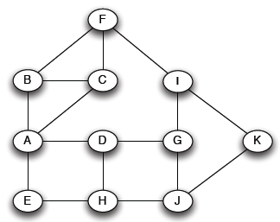
How to Compute Betweenness?
Want to compute
betweenness of paths starting at node A
Breadth first search starting from A:
0
1
2
3
4

Slide 47
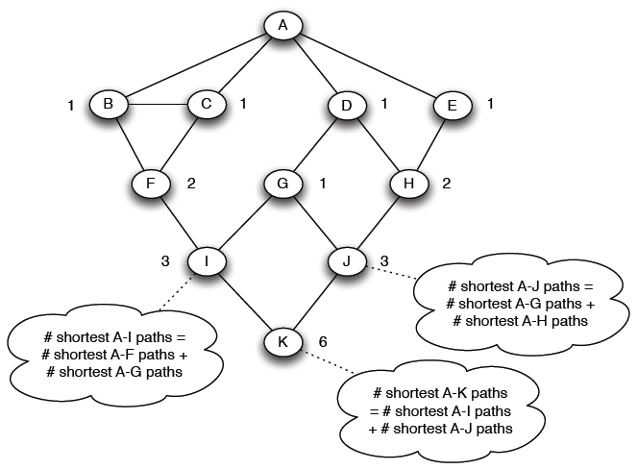
How to Compute Betweenness?
Count the number of shortest paths from A to all other nodes of the network:

Slide 48
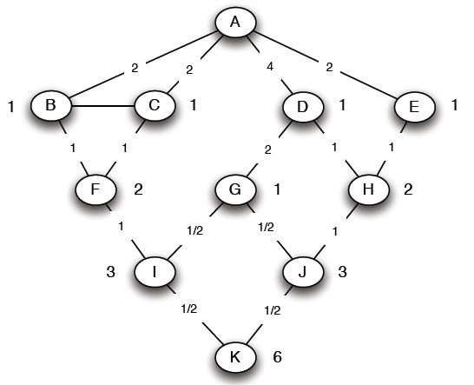
How to Compute Betweenness?
Compute betweenness by working up the tree: If there are multiple paths count them fractionally
The algorithm:
Add edge flows:
-- node flow =
1+∑child edges
-- split the flow up based on the parent value
Repeat the BFS procedure for each starting node
1+1 paths to H
Split evenly
1+0.5 paths to J
Split 1:2
1 path to K.
Split evenly

Slide 49
How to Compute Betweenness?
Compute betweenness by working up the tree: If there are multiple paths count them fractionally
The algorithm:
Add edge flows:
-- node flow =
1+∑child edges
-- split the flow up based on the parent value
Repeat the BFS procedure for each starting node
1+1 paths to H
Split evenly
1+0.5 paths to J
Split 1:2
1 path to K.
Split evenly

Slide 50

How to select number of clusters?
Define modularity to be
Q = (number of edges within groups) – (expected number within groups)
Actual number of edges between i and j is
Expected number of edges between i and j is
m…number of edges
Notes:
Ki and Kj are degrees of vertices
And m is the total number of edges in the network
Aij = adjacency matrix
Q can be +ve or –ve
+ve values means presence of community structure

Slide 51
Modularity: Definition
Q = (number of edges within groups) – (expected number within groups)
Then:
Modularity lies in the range [−1,1]
  It is positive if the number of edges within groups exceeds the expected number
  0.3<Q<0.7 means significant community structure
  m … number of edges
  A_{ij} … 1 if (i,j) is edge, else 0
  k_{i} … degree of node i
  c_{i} … group id of node i
  δ(a, b) … 1 if a=b, else 0

Slide 52
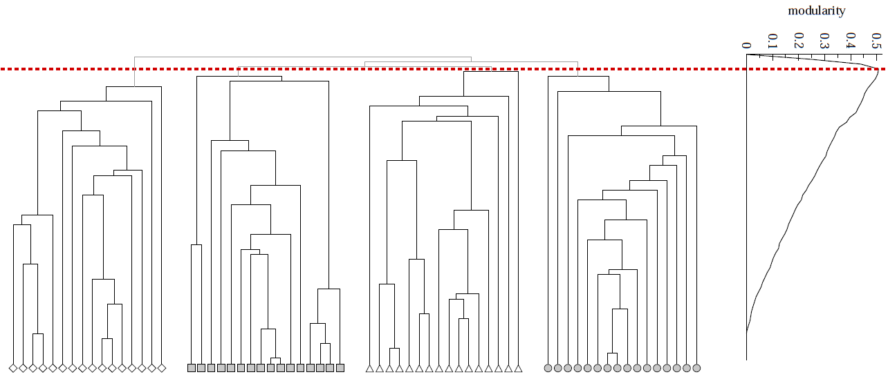
Modularity: Number of clusters
Modularity is useful for selecting the
number of clusters:
Q
Why not optimize modularity directly?
Notes:
HW: Question – come up with a graph where GIRVAN-NEWMAN MODULARITY IS NOT UNIMODAL

