Slide 1
Adaptively Parallelizing Distributed Range Queries
Ymir Vigfusson
Adam Silberstein
Brian Cooper
Rodrigo Fonseca

Slide 2
Introduction
Well understood database tasks are challenging again at web-scale
Millions of users
Terabytes of data
Low latency essential
Shared-nothing databases
Scale by adding servers with local disks

Slide 3
Introduction
PNUTS
Workload:
Analogous to OLTP
Random reads and updates of individual records
Online applications

Slide 4
Range Queries
Important for web workloads
Time ordered data
Listing date | Item for sale
07-24-2009 | Used cowbell
08-10-2009 | 2003 Toyota
08-15-2009 | Red Snuggie
08-18-2009 | 1930 Ford
08-22-2009 | Harpsicord
Listing date | Item for sale
07-24-2009 | Used cowbell
08-10-2009 | 2003 Toyota
08-15-2009 | Red Snuggie
08-18-2009 | 1930 Ford
08-22-2009 | Harpsicord
New items

Slide 5
Range Queries
Important for web workloads
Time ordered data
Secondary indexes
Index
Base Table
Price | Item ID
$20 | 1727
$100 | 971
$1,500 | 251
$5,000 | 5578
$10,000 | 4921
Price | Item ID
$20 | 1727
$100 | 971
$1,500 | 251
$5,000 | 5578
$10,000 | 4921
Item ID | Item
1727 | Used cowbell
4921 | 2003 Toyota
971 | Red Snuggie
5578 | Harpsicord
251 | 1930 Ford
Item ID | Item
1727 | Used cowbell
4921 | 2003 Toyota
971 | Red Snuggie
5578 | Harpsicord
251 | 1930 Ford

Slide 6
Range Queries
Important for web workloads
Time ordered data
Secondary indexes
etc.
Could scan large fraction of the table
Short time to first result is crucial
Possibly a large number of results
Predicate might be selective
FIND ITEMS UNDER $100 WHERE
Category =‘Cars’ AND Quantity>0
FIND ITEMS OVER $100

Slide 7
Executing Range Queries
Makes sense to parallelize queries
Tables are partitioned over many servers
How parallel should a query be?
Too sequential: Slow rate of results
Too parallel: Client overloaded, wasting server resources

Slide 8
Executing Range Queries
Makes sense to parallelize queries
Tables are partitioned over many servers
How parallel should a query be?
Too sequential: Slow rate of results
Too parallel: Client overloaded, wasting server resources

Slide 9
PNUTS 101
get
set
delete
Clients
Partition map
Partition
Controller
Routers
Load balancer
Server monitor
T
Storage
Units
A
B
L
E

Slide 10
PNUTS + Range scans
get
set
delete
getrange
Clients
= query
Routers
SCAN
= ideal parallelism level
= ideal server concurrency
Storage
Units

Slide 11
Range query parameters
Equals number of disks (experimentally)
In our testbed,
When does parallelism help?
range size: longer = more benefit
query selectivity: fewer results = more benefit
client speed: faster = more benefit
Diminishing returns
= ideal parallelism level
= ideal server concurrency

Slide 12
Determining
As shown, many influential factors
End-to-end insight: match rate of new results to client’s uptake rate
% Client Capacity

Slide 13
Determining
As shown, many influential factors
End-to-end insight: match rate of new results to client’s uptake rate
Hard to measure client rate directly
% Client Capacity

Slide 14
Adaptive server allocation (ASA)
Measure client uptake speed
If higher, increase K by 1 and repeat
Optimal
Client saturated,
enter next phase
Periodically, flip a coin
K = 1
Time
On Heads
Increase K by 1
Improvement?
Keep increasing K
No?
Revert to old K
On Tails
Decrease K by 1
Performance same?
Keep decreasing K
No?
Revert to old K

Slide 15
Adaptive server allocation (ASA)
Measure client uptake speed
If higher, increase K by 1 and repeat
Real
Experimental Testbed
Client saturated,
enter next phase
Clients
x 4
T
K = 1
Time
20M records
1024 partitions
100MB/partition
100 partitions/server
A
B
Periodically, flip a biased coin w.p. 2/3
On heads, increase or decrease K by 1
If no improvement, revert to old K
Otherwise, keep K and go in the same direction
next time we change it.
Routers
x 1
T
A
B
Storage
Units
L
E
x 10

Slide 16
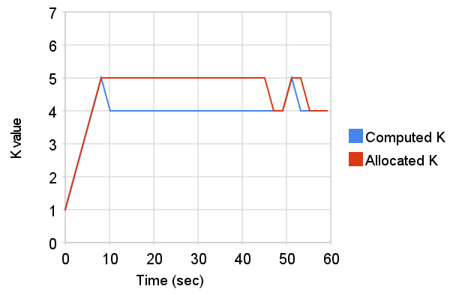
Adaptive server allocation (ASA)
x 1

Slide 17
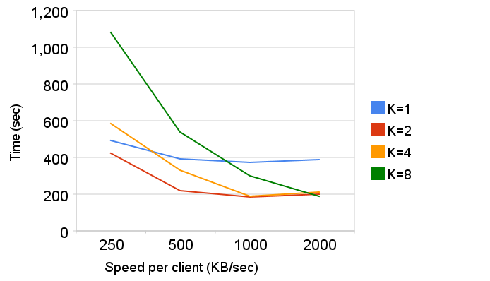
Adaptive server allocation (ASA)
x 4

Slide 18
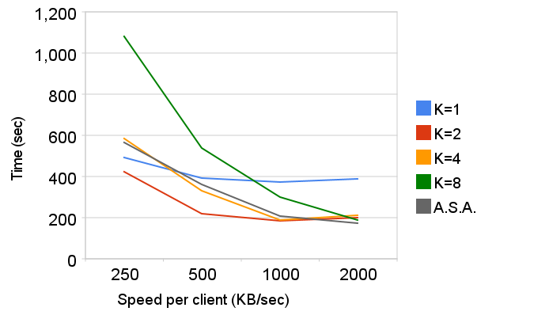
Adaptive server allocation (ASA)
x 4

Slide 19
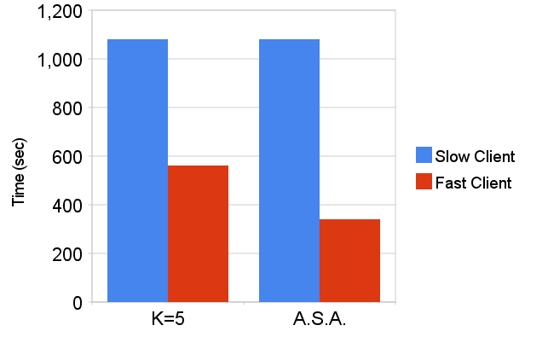
Adaptive server allocation (ASA)
x 2
K=5
K=5
K=2
K=8

Slide 20
Single Client
Clients
Routers
SCAN
Storage
Units

Slide 21
Multiple Clients
Clients
Routers
SCAN
SCAN
Storage
Units

Slide 22
Multiple Clients
Clients
Routers
Scheduler
SCAN
SCAN
Storage
Units

Slide 23
Scheduler Service
Scan engine shares query information with central scheduler
Servers which hold needed partitions
Parallelism level
Scheduler decides on who-should-go-where-when to minimize contention
How do we schedule multiple queries?

Slide 24
Scheduler Service
Scan engine shares query information with central scheduler
Servers which hold needed partitions
Parallelism level
Scheduler decides on who-should-go-where-when to minimize contention
How do we schedule multiple queries?

Slide 25
Scheduling Wishlist
All queries should finish quickly
Give preference to higher priority queries
Prefer steady rate of results over bursts

Slide 26
Scheduling Wishlist
All queries should finish quickly
Give preference to higher priority queries
Prefer steady rate of results over bursts
= Minimize
makespan
Thm: The makespan of any greedy heuristic is at most 2∙OPT

Slide 27
Scheduling Heuristic
All queries should finish quickly
Give preference to higher priority queries
Prefer steady rate of results over bursts
Priority preference parameter
Current idle period
Greedily schedule queries in order by

Slide 28
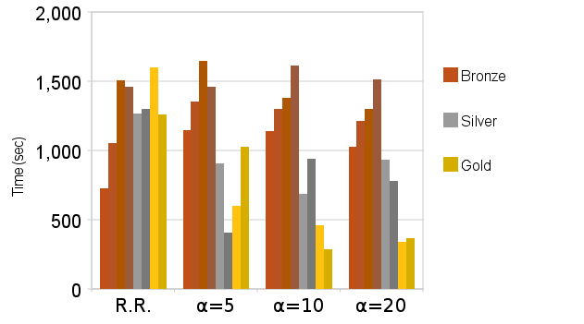
Scheduler - Priority
Priority=1
Priority=2
Priority=4

Slide 29
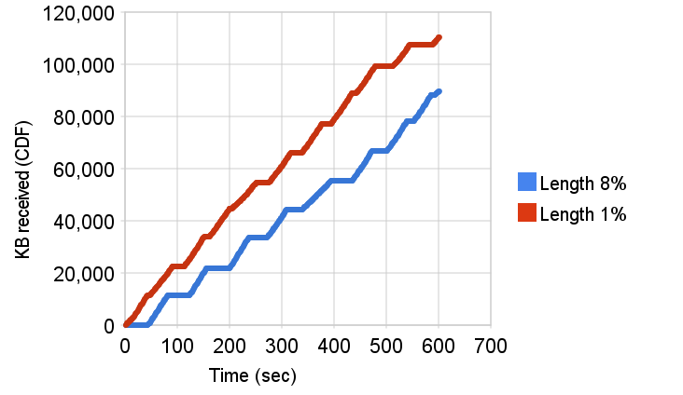
Scheduler – Result stream
Priority=1
Priority=4

Slide 30
Scheduler
All queries should finish quickly
Give preference to higher priority queries
Prefer steady rate of results over bursts

Slide 31
Conclusion
Supporting range queries at web-scale is challenging
Too little: client suffers, too much: servers suffer
Adaptive server allocation algorithm
Greedy algorithm run by central scheduler
Provably short makespan
Respects priorities and provides a steady stream of results
Our solution is entering production soon.
How parallel should a query be?
How do we schedule multiple queries?

Slide 33
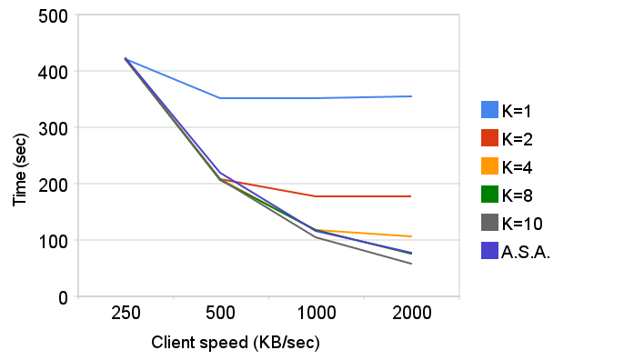
Adaptive server allocation (ASA)
x 1
K=2
K=3
K=5
K=8

Slide 34
Scheduling Wishlist
All queries should finish quickly
Give preference to higher priority queries
Prefer steady rate of results over bursts
= Minimize
makespan
Thm: The makespan of any greedy heuristic is at most 2∙OPT
Thm: OPT is exactly

Slide 35
Scheduling Wishlist
All queries should finish quickly
Give preference to higher priority queries
Prefer steady rate of results over bursts
Priority bias parameter
Greater penalty for long idle time
E.g., gold/silver/bronze customers
Or minimum completion time = OPT
Set of idle time periods

Slide 36
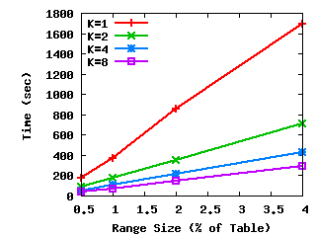
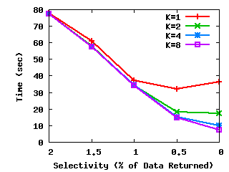
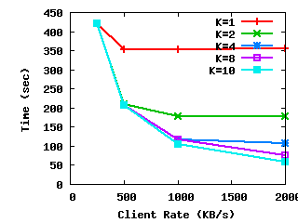
Impact of parallelism
Range size: Longer queries = more benefit from parallelism.
Diminishing returns
Query Selectivity: Fewer results = more benefit from parallelism
Client Rate: Faster clients = more benefit from parallelism
Saturated clients do not benefit from extra servers

Slide 37
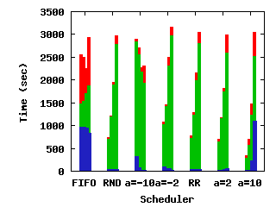
Scheduler - Priority
Query lengths 1,2,4,8%
Max. completion time
Avg. completion time
Time of first result
Current idle period
Greedily schedule queries in order by

Slide 38
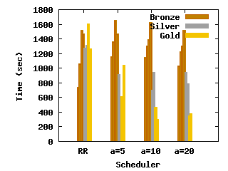
Scheduler - Priority
Query lengths 1,2,4,8%
Different priorities
Greedily schedule queries in order by

Slide 39
Road map
System and problem overview
Adaptive server allocation
Multi-query scheduling
Conclusion

Slide 40
Experimental test bed
Clients
Clients
x 4
T
20M records
1024 partitions
100MB/partition
100 partitions/server
A
B
Routers
x 1
Storage
Units
x 10
L
E

Slide 41
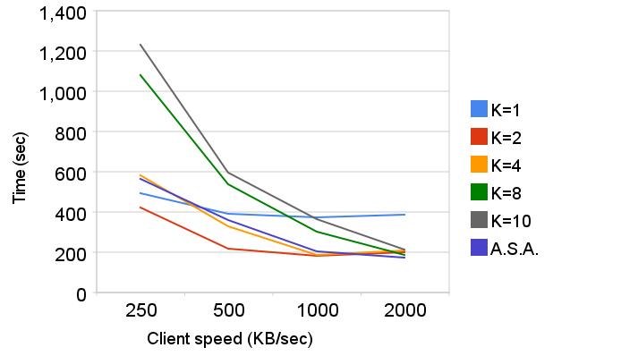
Adaptive server allocation (ASA)
x 4

Slide 42
PNUTS 101
Clients
Partition map
Tablet
Controller
Routers
Load balancer
Server monitor
T
A
B
L
E
Storage
Units
T
A
B
L
E

